Slide 1
Topic: Trigonometry
EQ: What is the relationship between an angle and the labelling of sides in a triangle?

Slide 2
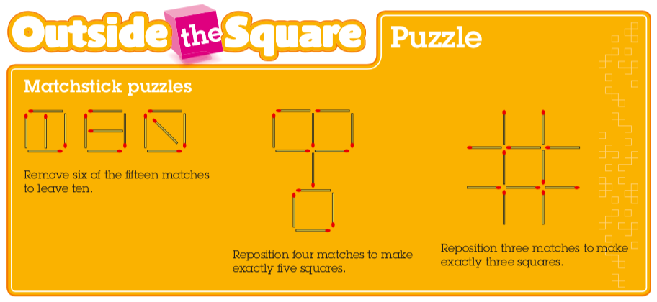
Topic: Trigonometry
EQ: What is the relationship between an angle and the labelling of sides in a triangle?

Slide 3
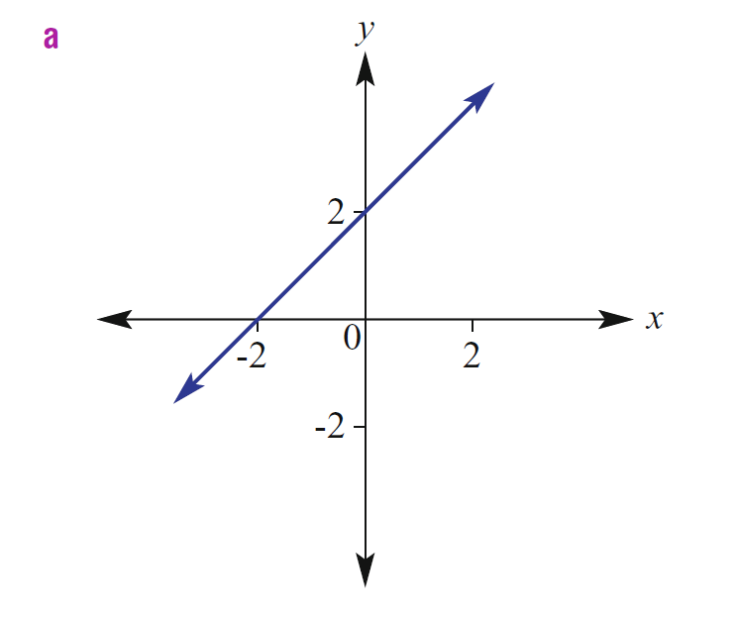

The Daily 5
If 12 people in this class have brown hair and 10 have black hair, write the ratio of brown hair to black hair
If $5 can buy you 3 chocolate bars, how many bars can you buy with $20?
If it takes 10 people 6 days to build a car, how long would it take 20 people to build the same car?
What is the gradient and y-intercept
of the following graph?
5. What is the gradient of this line:

Slide 4
Topic: Trigonometry
EQ: What is the relationship between an angle and the labelling of sides in a triangle?
First, a review of similarity:
Two shapes are said to be similar to each other if one is an enlargement of the other.
Angles stay the same, side lengths change
What do you notice about the length of the sides?
What do you notice about the size of the angles?

Slide 5
Topic: Trigonometry
EQ: What is the relationship between an angle and the labelling of sides in a triangle?
Similar Triangles
Can be overlayed one on top of the other – so it’s easy to see corresponding angles are equal

Slide 6
Topic: Trigonometry
EQ: What is the relationship between an angle and the labelling of sides in a triangle?
If 2 triangles are similar, then their matching pairs of sides are in ratio
c
a
d
b
e
f
Provided they’re similar, that is, the angles of one are equal to angles of the other

Slide 7
Topic: Trigonometry
EQ: What is the relationship between an angle and the labelling of sides in a triangle?
Trigonometry helps us find angles and side lengths in a triangle. It is used in science, engineering, video games and more.
Trigonometry uses three functions, these are called:
Sine (shortened to Sin and pronounced “sign”)
Cosine (shortened to Cos)
Tangent (shortened to Tan)
Before we learn about these functions, we need to be able to accurately label the sides of a triangle

Slide 8
Topic: Trigonometry
EQ: What is the relationship between an angle and the labelling of sides in a triangle?
But before that, a video. Check the 2:15 mark for an answer to the age old student question of “when am I ever going to use this?”
https://ed.ted.com/lessons/pixar-the-math-behind-the-movies-tony-derose
Notes:
Teachers beware: this video is 7:33, it might be worth only showing the first 3-4 minutes.

Slide 9
Parts of a Right Triangle
Topic: Trigonometry
EQ: What is the relationship between an angle and the labelling of sides in a triangle?
The hypotenuse will always be the longest side, and opposite from the right angle.
The opposite side is the side that is on the opposite side of the triangle from Angle A.
Imagine that you are at Angle A looking into the triangle.
The adjacent side is the side next to Angle A.

Slide 10
Parts of a Right Triangle
Topic: Trigonometry
EQ: What is the relationship between an angle and the labelling of sides in a triangle?
From Angle B the opposite side is the side that is on the opposite side of the triangle.
From Angle B the adjacent side is the side next to Angle B.
*Labelling the sides depends on what angle you are using*
Now imagine that you move from Angle A to Angle B.

Slide 11
What is the side marked with an X?
X
ϴ
Adjacent
Opposite
A)
B)
Hypotenuse
C)

Slide 12
What is the side marked with an X?
ϴ
X
A)
B)
Opposite
C)
Hypotenuse
Adjacent

Slide 13
What is the side marked with an X?
X
ϴ
A)
Hypotenuse
B)
Opposite
C)
Adjacent

Slide 14
What is the side marked with an X?
X
ϴ
A)
Adjacent
B)
Opposite
C)
Hypotenuse

Slide 15
What is the side marked with an X?
X
ϴ
Opposite
Adjacent
C)
Hypotenuse
A)
B)

Slide 16

Topic: Trigonometry
EQ: What is the relationship between an angle and the labelling of sides in a triangle?

Slide 17
Class/Homework
Intro to Trig Worksheet T1 – Labelling triangles
Complete your summary

